Slide 1
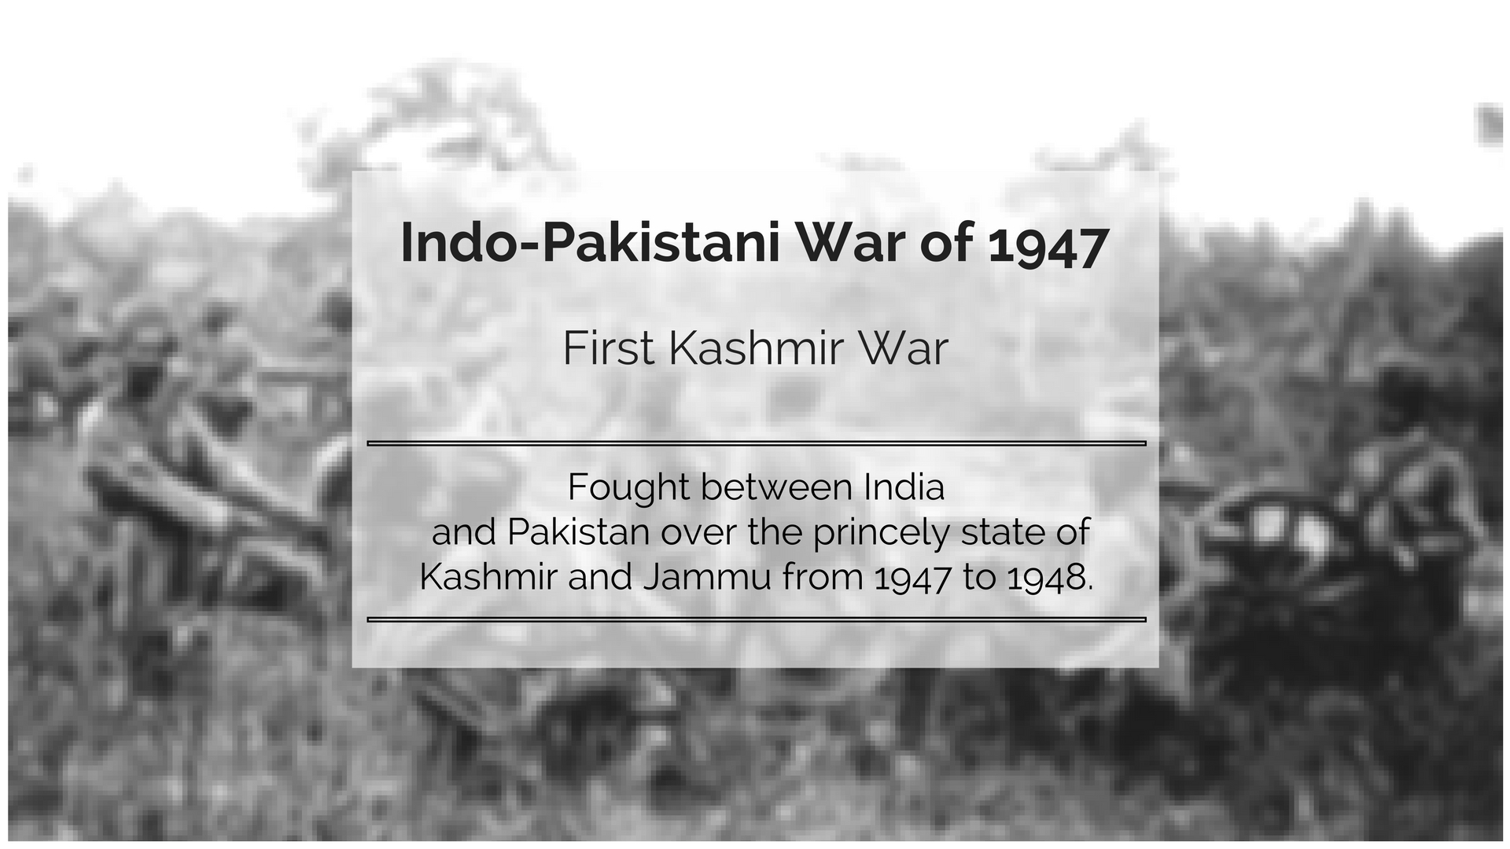

Slide 2
Cause
1947
Jinnah
Partition of the two nations
British Policy
June 3, 1947 : Declaration of Independence
Indian Army
22 states - Instrument of Accession
Ind vs Pak
Hyderabad, Junagadh, Kashmir
Success
1965
1971
Azad Kashmir
War Ends

Slide 3
Cause
Jinnah’s advisors came up with a plan
Jinnah
To create religious tension in border areas
and rob the villages in different groups
British Policy
Captured Gilgit by force using propaganda
Indian Army
Attacks started from September by
Tribesmen and the Pakistani soldiers.
Ind vs Pak
October 24: Asked for help from India
Success
October 26: Acceded India
Azad Kashmir
Situations worsened in Baramulla
War Ends

Slide 4
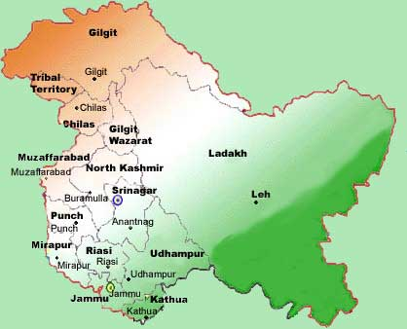
Cause
The tribesmen got distracted from their way after the robbery
Jinnah
British Policy
While Jinnah was readying his victory march, Indian army proceeded towards Pakistan
Indian Army
Ind vs Pak
Success
Jinnah gave a decree to the then Commander in Chief, General Sir Douglous Gresi, to send the army to Pakistan
Azad Kashmir
Supreme Commander of Pakistani Army, Field Marshall Sir Claude Aukinley denied it as India’s action was justified
War Ends

Slide 5
Cause
The day Hari Singh acceded to India in need of help, the Indian Army was ready to put in all their efforts to take the necessary action and put the circumstances under control
Jinnah
British Policy
Mahatma Gandhi was disturbed after listening to the situations in Kashmir and advised Nehru to send the army to save the lives of Kashmiri people
Indian Army
Delhi’s air force base sent out the best of their officers to Srinagar - This was their first chance to fight under their own flag – They had all the courage they needed to save their nation – Brigadier Sen
Ind vs Pak
Success
Guerilla War by tribesmen made it difficult for the army
Azad Kashmir
They attacked once they saw the army was in a smaller group to enter Srinagar – Ratio of enemies to the army was 7:1 - They still kept them engaged for 6 hours – Major Somnath Sharma
War Ends

Slide 6
Cause
War ended before help was received
Jinnah
Enemies dropped the idea of moving towards Srinagar
Because of Major Somnath - enough time to seal entries to Srinagar
British Policy
No open war and regional advantages to the enemies
Strength of the Indian Army lay in their motivation
November 1 – India Pakistan talk at Lahore – Jinnah
Indian Army
Ind vs Pak
Success
According to Retired Colonel Anil Athale, if in 1947/1948 India would have decided to destroy Pakistan, they easily could have, and Jinnah was aware of that, hence he did not send in his army openly rather chose to attack through the tribesmen and staged the drama by saying they are voluntary attacking and he has no role to play in the same
Azad Kashmir
War Ends

Slide 7
Cause
November 4 –
Sardar Patel meets Brigadier Sen
Promised more men by November 7 for Kashmir
November 7 – Tribesmen hiding in Shalteng
Jinnah
British Policy
Brigadier Sen decided to attack immediately
Open war in counter to their guerilla war
Surrounded them from all sides and air as well
Indian Army
Ind vs Pak
Success
Success motivated them to Baramulla
November 8 – reach Baramulla - Silence
November 13 – all enemies wiped off Srinagar Valley
Azad Kashmir
War Ends

Slide 8
Cause
Started the rebellious organization – “Government of Azad Kashmir”
Jinnah
Militants = terror/danger in border areas
Poonch – home to refugees – extreme weather
Had to set priorities straight to not lose
British Policy
Indian Army
Enemies moving towards Naushera - captured Mirpur and Jhangar
Ind vs Pak
Jan 20- General Kariappa took up his role
Vision towards Naushera – everything fell in place
Brigadier Mohammed Usmaan – Motherland
Success
Azad Kashmir
Captured Kot to avoid any weakness and destroyed enemies
War Ends

Slide 9
Cause
February 6 – Pakistan retaliated – attacked Naushera – biggest fight of the 1947-48 war
Jinnah
Jadunath Singh – 1 out of 27 mean who was remaining - injured
British Policy
Enemies were 15 steps away – he came out of his hiding
Started shooting suddenly which took the enemies aback
Rescue help came by that time to defeat the enemies
Indian Army
Ind vs Pak
The fight went on till late at night, but the war was ended and the enemies were subdued
Success
Victory was achieved
Azad Kashmir
India lost 33 soldiers, while 102 were injured.
War Ends

Slide 10
Reference
vande matram aaj tak episode 4 - आजादी के साथ ही मिल गया जंग का नासूर
( https://www.youtube.com/watch?v=FUjFRiJ-G-M )

Slide 11
Thank you ☺
Questions?

